Slide 1
本讲内容
k-NN分类
预测
分类的准确性

Slide 2
k-Nearest Neighbors
Definition: Given a query point p, and a distance function dist(), let q_{k} be a point in the database such that
  count( {q| dist(p,q) < =dist(p,q_{k}), q ∈D} ) = k-1
The k-nearest neighbors of p are all points q such that dist(p,q) <= dist(p,q_{k})
k=10
q_{k}
p

Slide 3
k-NN分类
每个训练样本都看作n维空间中的一个点。
给定一个未知样本（类似于查询点q）， 首先找到该样本的k个近邻，将这k个近邻按照类标号进行分组，未知样本最终被分到组员最多的那个组。

Slide 4

kNN classiﬁcation
kNN classiﬁcation is another vector space classiﬁcation
method.
It also is very simple and easy to implement.
kNN is more accurate (in most cases) than Naive Bayes and
Rocchio.
If you need to get a pretty accurate classiﬁer up and running
in a short time ...
...and you don’t care about eﬃciency that much ...
...use kNN.

Slide 5

kNN classiﬁcation
kNN = k nearest neighbors
kNN classiﬁcation rule for k = 1 (1NN): Assign each test
document to the class of its nearest neighbor in the training
set.
1NN is not very robust – one document can be mislabeled or
atypical.
kNN classiﬁcation rule for k > 1 (kNN): Assign each test
document to the majority class of its k nearest neighbors in
the training set.
Rationale of kNN: contiguity hypothesis
We expect a test document d to have the same label as the
training documents located in the local region surrounding d.

Slide 6
Probabilistic kNN

Slide 7
Probabilistic kNN
Probabilistic version of kNN: P(c|d) = fraction of k neighbors
of d that are in c

Slide 8
Probabilistic kNN
Probabilistic version of kNN: P(c|d) = fraction of k neighbors
of d that are in c
kNN classiﬁcation rule for probabilistic kNN: Assign d to class
c with highest P(c|d)

Slide 9
Exercise

Slide 10

Exercise
x
x
x
x
x
x
x
o
o
o
o
x
x
o
x
How is star classiﬁed by:
(i) 1-NN (ii) 3-NN (iii) 9-NN (iv) 15-NN (v) Rocchio?

Slide 11
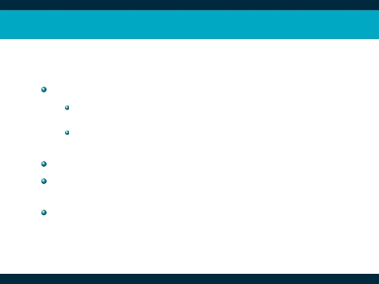
kNN: Discussion
No training necessary
But linear preprocessing of documents is as expensive as
training Naive Bayes.
We always preprocess the training set, so in reality training
time of kNN is linear.
kNN is very accurate if training set is large.
But kNN can be very inaccurate if training set is small.

Slide 12
本讲内容
k-NN分类
预测
分类的准确性

Slide 13
What Is Prediction?
Prediction is similar to classification
  First, construct a model
  Second, use model to predict unknown value
Major method for prediction: regression
  Linear and multiple regression
  Non-linear regression
Prediction is different from classification
  Classification refers to predict categorical class label
  Prediction models continuous-valued functions

Slide 14
有一些软件包解决回归问题。例如:
  SAS(http://www.sas.com)
  SPSS(http://www.spss.com)
  S-Plus(http://www.mathsoft.com)。

Slide 15
Linear regression
在线性回归中，数据用直线建模。是最简单的回归形式。
双变量回归将一个随机变量Y（称作响应变量）视为另一个随机变量X（称为预测变量）的线性函数。即：
Y = α + βX

Slide 16
Linear regression
在线性回归中，数据用直线建模。是最简单的回归形式。
双变量回归将一个随机变量Y（称作响应变量）视为另一个随机变量X（称为预测变量）的线性函数。即：
Y = α + βX
其中，α和β是回归系数
建模的过程主要是求回归系数，常用的方法：
  最小二乘法

Slide 17
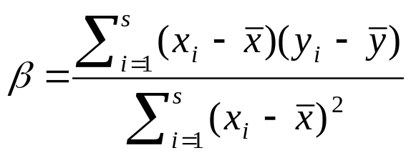
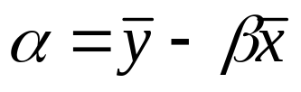


用最小二乘法求回归系数
给定s个样本或形如(x₁,y₁), (x₂,y₂),…, (x_{s},y_{s})的数据点，回归系数α和β可以用下式计算：
其中，是x₁, x₂ ,.., x_{s}的平均值，而 是y₁, y₂ ,.., y_{s}的平均值。
与其它复杂的回归方法相比，线性回归常常给出很好的近似。

Slide 18
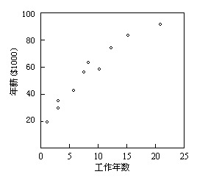
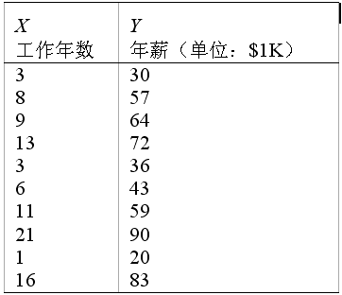
用最小二乘法求回归系数:例子

Slide 19
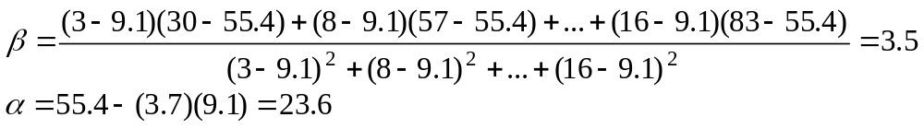
用最小二乘法求回归系数:例子
用方程Y = α + βX表示年薪和工作年数之间的关系。
给定左图数据，计算出
= 9.1， = 55.4。

Slide 20
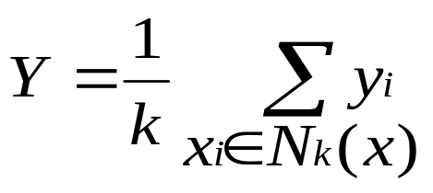
用k-NN进行线性回归
给定样本x, 根据训练集求出它的k个近邻，则：

Slide 21
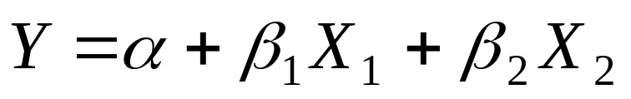
multiple regression
多元回归是线性回归的扩展，涉及多个预测变量。
响应变量Y可以是一个多维特征向量的线性函数。
基于两个预测属性或变量X1和X2的多元回归模型的例子是
最小二乘法同样可以用在这里求解α，β1和β2

Slide 22
Non-linear regression
通过在基本线性模型上添加多项式项，多项式回归可以用于建模。
通过对变量进行变换，可以将非线性模型转换成线性的，然后用最小二乘法求解。

Slide 23
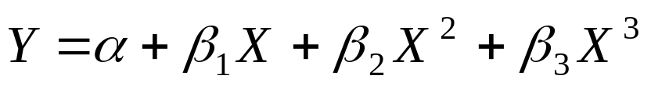

Non-linear regression
例 下面的三次多项式
通过定义如下新变量：
X₁ = X X ₂ = X ² X ₃ =X ³
可以转换成线性形式，结果为：

Slide 24
本讲内容
k-NN分类
预测
分类的准确性

Slide 25
评估分类法的准确率
保持和k-交叉确认是两种常用的评估分类法准确率的技术

Slide 26
保持法
给定数据随机地划分成两个独立的集合：训练集和测试集。通常，三分之二的数据分配到训练集，其余三分之一分配到测试集。
随机选样：是保持方法的一种变形，它将保持方法重复k次。总体准确率估计取k次迭代的平均值。

Slide 27
k-交叉确认
初试数据被划分成k个互不相交的子集S ₁ ， S ₂ ，... ， S _{k}，每个子集的大小大致相等。
训练和测试进行k次。在第i次迭代，S _{i}用作测试集，其余的子集都用于训练集。即，第一次迭代在子集S ₂,...,S _{k}上训练，而在S₁上测试；第二次迭代的分类法在子集S ₁, S ₃,...,S _{k}上训练，而在S₂上测试；如此下去。
准确率是k次迭代过程中分类结果正确的样本数除以样本总数。

Slide 28
提高准确率的方法
装袋（Bagging）和 推进 (Boosting)
假定你是一个病人，希望根据你的症状进行诊断。你可能选择看多个医生，而不是一个。如果某种诊断比其它诊断出现的次数多，你可能将它作为最终或最好的诊断。现在，将医生换成分类法，你就可以直观地理解装袋。
假定你根据医生以前诊断的准确率，对每个医生的诊断“值”或价值赋予一个权值，则最终的诊断是加权的诊断的组合。这就是推进的基本思想。

Slide 29
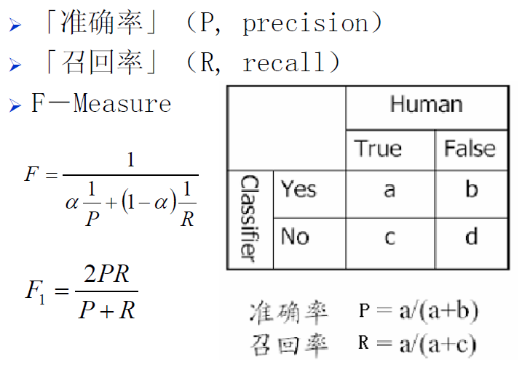
评价指标

Slide 30
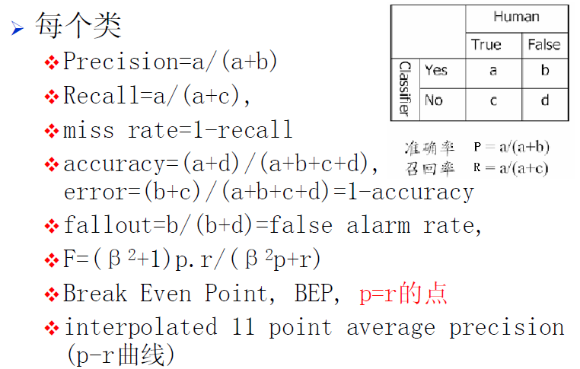
评价指标

Slide 31
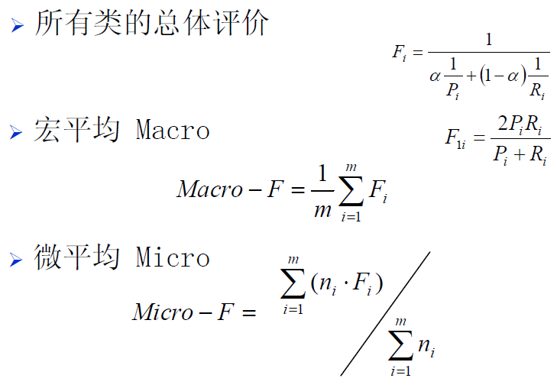
评价指标

Slide 32
ROC

Slide 33
AUC

Slide 34
总结
Classification is an extensively studied problem (mainly in statistics, machine learning & neural networks)
Classification is probably one of the most widely used data mining techniques with a lot of extensions
Scalability is still an important issue for database applications: thus combining classification with database techniques should be a promising topic
Research directions: classification of non-relational data, e.g., text, spatial, multimedia, etc..

Slide 35
作业1：
1.Explain why RainForest is a scalable method for decision-tree induction in large databases.
2.Workout a similar scalable induction method for Naive-Bayesian algorithm.
3. Outline a scalable method for support vector machines.

